Slide 1
Unit 5:Transactions
By : Parul Madan

Slide 2
Chapter 14: Transactions
Transaction Concept
Transaction State
Concurrent Executions
Serializability
Implementation of Isolation

Slide 3
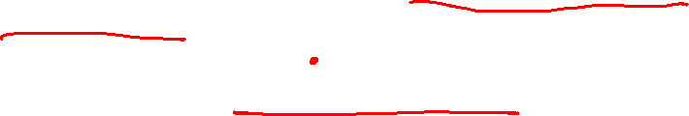
Transaction State
Active – the initial state; the transaction stays in this state while it is executing
Partially committed – after the final statement has been executed.
Failed -- after the discovery that normal execution can no longer proceed.
Aborted – after the transaction has been rolled back and the database restored to its state prior to the start of the transaction. Two options after it has been aborted:
  restart the transaction
    can be done only if no internal logical error
  kill the transaction
Committed – after successful completion.

Slide 4

Transaction State (Cont.)

Slide 5
Transaction Concept
A transaction is a unit of program execution that accesses and possibly updates various data items.
E.g. transaction to transfer $50 from account A to account B:
  1. read(A)
  2. A := A – 50
  3. write(A)
  4. read(B)
  5. B := B + 50
  6. write(B)
Two main issues to deal with:
  Failures of various kinds, such as hardware failures and system crashes
  Concurrent execution of multiple transactions

Slide 6
Example of Fund Transfer
Transaction to transfer $50 from account A to account B:
  1. read(A)
  2. A := A – 50
  3. write(A)
  4. read(B)
  5. B := B + 50
  6. write(B)
Atomicity requirement
  if the transaction fails after step 3 and before step 6, money will be “lost” leading to an inconsistent database state
    Failure could be due to software or hardware
  the system should ensure that updates of a partially executed transaction are not reflected in the database
Durability requirement — once the user has been notified that the transaction has completed (i.e., the transfer of the $50 has taken place), the updates to the database by the transaction must persist even if there are software or hardware failures.

Slide 7
Example of Data Access
buffer
Buffer Block A
input(A)
X
A
Buffer Block B
Y
B
output(B)
read(X)
write(Y)
x₂
x₁
y₁
work area
of T₁
work area
of T₂
memory
disk

Slide 8
Example of Fund Transfer (Cont.)
Transaction to transfer $50 from account A to account B:
  1. read(A)
  2. A := A – 50
  3. write(A)
  4. read(B)
  5. B := B + 50
  6. write(B)
Consistency requirement in above example:
  the sum of A and B is unchanged by the execution of the transaction
In general, consistency requirements include
    Explicitly specified integrity constraints such as primary keys and foreign keys
    Implicit integrity constraints
      e.g. sum of balances of all accounts, minus sum of loan amounts must equal value of cash-in-hand
  A transaction must see a consistent database.
  During transaction execution the database may be temporarily inconsistent.
  When the transaction completes successfully the database must be consistent
    Erroneous transaction logic can lead to inconsistency

Slide 9
Example of Fund Transfer (Cont.)
Isolation requirement — if between steps 3 and 6, another transaction T2 is allowed to access the partially updated database, it will see an inconsistent database (the sum A + B will be less than it should be).
T1 T2
  1. read(A)
  2. A := A – 50
  3. write(A)
  read(A), read(B), print(A+B)
  4. read(B)
  5. B := B + 50
  6. write(B
Isolation can be ensured trivially by running transactions serially
  that is, one after the other.
However, executing multiple transactions concurrently has significant benefits, as we will see later.

Slide 10
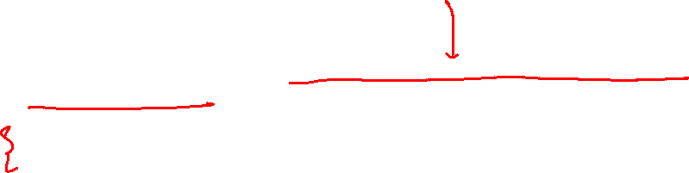
ACID Properties
A transaction is a unit of program execution that accesses and possibly updates various data items.To preserve the integrity of data the database system must ensure:
Atomicity. Either all operations of the transaction are properly reflected in the database or none are.
Consistency. Execution of a transaction in isolation preserves the consistency of the database.
Isolation. Although multiple transactions may execute concurrently, each transaction must be unaware of other concurrently executing transactions. Intermediate transaction results must be hidden from other concurrently executed transactions.
  That is, for every pair of transactions T_{i} and T_{j}, it appears to T_{i} that either T_{j}, finished execution before T_{i} started, or T_{j} started execution after T_{i} finished.
Durability. After a transaction completes successfully, the changes it has made to the database persist, even if there are system failures.

Slide 11
Concurrent Executions
Multiple transactions are allowed to run concurrently in the system. Advantages are:
  increased processor and disk utilization, leading to better transaction throughput
    E.g. one transaction can be using the CPU while another is reading from or writing to the disk
  reduced average response time for transactions: short transactions need not wait behind long ones.
Concurrency control schemes – mechanisms to achieve isolation
  that is, to control the interaction among the concurrent transactions in order to prevent them from destroying the consistency of the database
    Will study in Chapter 16, after studying notion of correctness of concurrent executions.

Slide 12
Schedules
Schedule – a sequences of instructions that specify the chronological order in which instructions of concurrent transactions are executed
  a schedule for a set of transactions must consist of all instructions of those transactions
  must preserve the order in which the instructions appear in each individual transaction.
A transaction that successfully completes its execution will have a commit instructions as the last statement
  by default transaction assumed to execute commit instruction as its last step
A transaction that fails to successfully complete its execution will have an abort instruction as the last statement

Slide 13

Schedule 1
Let T₁ transfer $50 from A to B, and T₂ transfer 10% of the balance from A to B.
A serial schedule in which T₁ is followed by T₂ :

Slide 14

Schedule 2
A serial schedule where T₂ is followed by T₁

Slide 15


Schedule 3
Let T₁ and T₂ be the transactions defined previously. The following schedule is not a serial schedule, but it is equivalent to Schedule 1.
In Schedules 1, 2 and 3, the sum A + B is preserved.

Slide 16


Schedule 4
The following concurrent schedule does not preserve the value of (A + B ).

Slide 17
Serializability
Basic Assumption – Each transaction preserves database consistency.
Thus serial execution of a set of transactions preserves database consistency.
A (possibly concurrent) schedule is serializable if it is equivalent to a serial schedule. Different forms of schedule equivalence give rise to the notions of:
  1. conflict serializability
  2. view serializability

Slide 18
Simplified view of transactions
  We ignore operations other than read and write instructions
  We assume that transactions may perform arbitrary computations on data in local buffers in between reads and writes.
  Our simplified schedules consist of only read and write instructions.

Slide 19
Conflicting Instructions
Instructions l_{i} and l_{j} of transactions T_{i} and T_{j} respectively, conflict if and only if there exists some item Q accessed by both l_{i} and l_{j}, and at least one of these instructions wrote Q.
1. l_{i} = read(Q), l_{j} = read(Q). l_{i} and l_{j} don’t conflict.
2. l_{i} = read(Q), l_{j} = write(Q). They conflict.
3. l_{i} = write(Q), l_{j} = read(Q). They conflict
4. l_{i} = write(Q), l_{j} = write(Q). They conflict
Intuitively, a conflict between l_{i} and l_{j} forces a (logical) temporal order between them.
  If l_{i} and l_{j} are consecutive in a schedule and they do not conflict, their results would remain the same even if they had been interchanged in the schedule.

Slide 20
Conflict Serializability
If a schedule S can be transformed into a schedule S´ by a series of swaps of non-conflicting instructions, we say that S and S´ are conflict equivalent.
We say that a schedule S is conflict serializable if it is conflict equivalent to a serial schedule

Slide 21


Conflict Serializability (Cont.)
Schedule 3 can be transformed into Schedule 6, a serial schedule where T₂ follows T₁, by series of swaps of non-conflicting instructions. Therefore Schedule 3 is conflict serializable.
Schedule 3
Schedule 6

Slide 22
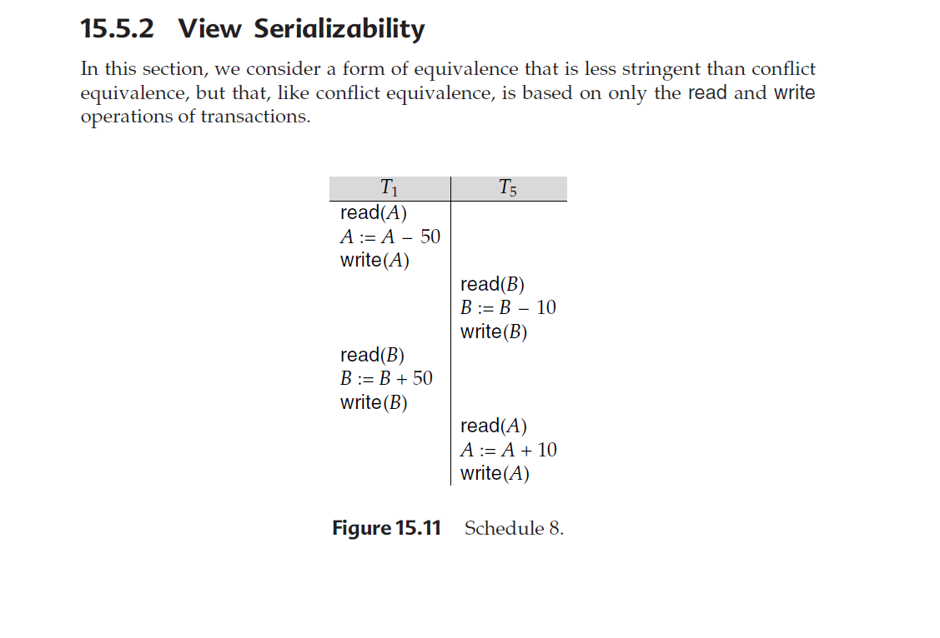

Slide 23
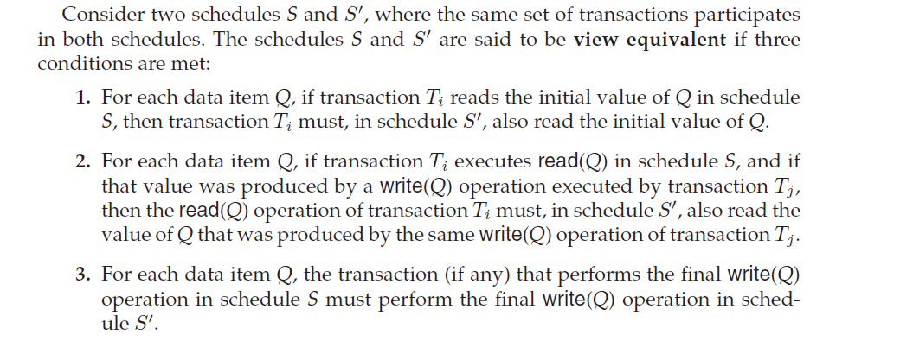

Slide 24
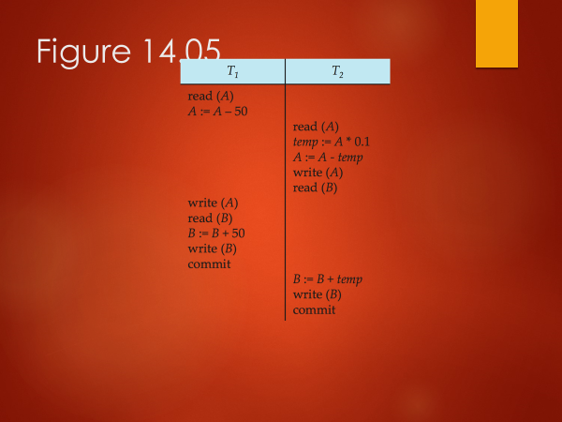
Figure 14.02

Slide 25
Testing of Serializability
Serialization Graph is used to test the Serializability of a schedule.
Assume a schedule S. For S, we construct a graph known as precedence graph. This graph has a pair G = (V, E), where V consists a set of vertices, and E consists a set of edges. The set of vertices is used to contain all the transactions participating in the schedule. The set of edges is used to contain all edges Ti ->Tj for which one of the three conditions holds:
1.Create a node Ti → Tj if Ti executes write (Q) before Tj executes read (Q).
2.Create a node Ti → Tj if Ti executes read (Q) before Tj executes write (Q).
3.Create a node Ti → Tj if Ti executes write (Q) before Tj executes write (Q).
If a precedence graph contains a single edge Ti → Tj, then all the instructions of Ti are executed before the first instruction of Tj is executed.
If a precedence graph for schedule S contains a cycle, then S is non-serializable. If the precedence graph has no cycle, then S is known as serializable.

Slide 26
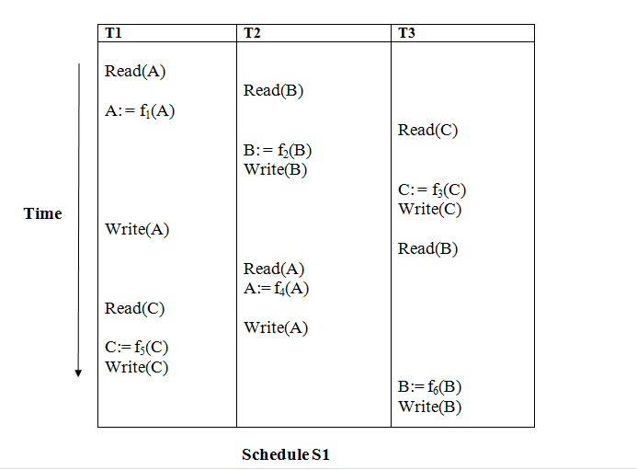

Slide 27
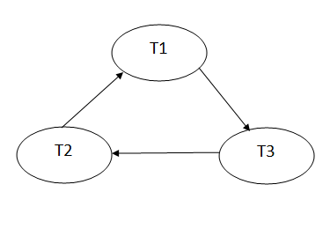
Explanation:
Read(A): In T1, no subsequent writes to A, so no new edges
Read(B): In T2, no subsequent writes to B, so no new edges
Read(C): In T3, no subsequent writes to C, so no new edges
Write(B): B is subsequently read by T3, so add edge T2 → T3
Write(C): C is subsequently read by T1, so add edge T3 → T1
Write(A): A is subsequently read by T2, so add edge T1 → T2
Write(A): In T2, no subsequent reads to A, so no new edges
Write(C): In T1, no subsequent reads to C, so no new edges
Write(B): In T3, no subsequent reads to B, so no new edges
Precedence graph for schedule S1:
The precedence graph for schedule S1 contains a cycle that's why Schedule S1 is non-serializable.

Slide 28
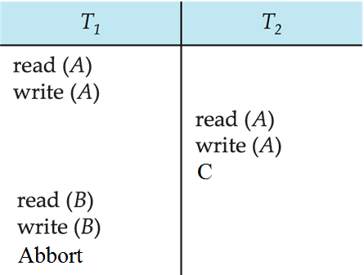
Anomalies with Interleaved Execution
Reading Uncommitted Data (WR Conflicts, “dirty reads”):

Slide 29
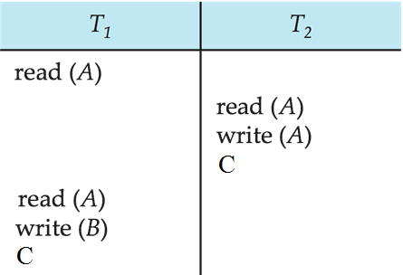
Anomalies with Interleaved Execution
Unrepeatable Reads (RW Conflicts):

Slide 30
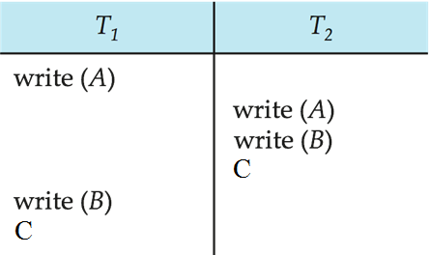
Anomalies (Continued)
Overwriting Uncommitted Data (WW Conflicts):
Notes:
Values of A and B are equal
T1 makes A & B are 1000
T2 makes A & B are 2000

Slide 31
End of Chapter 14

Slide 32
Figure 14.01

Slide 33
Figure 14.02

Slide 34
Figure 14.03

Slide 35
Figure 14.04

Slide 36
Figure 14.05

Slide 37
Figure 14.06

Slide 38
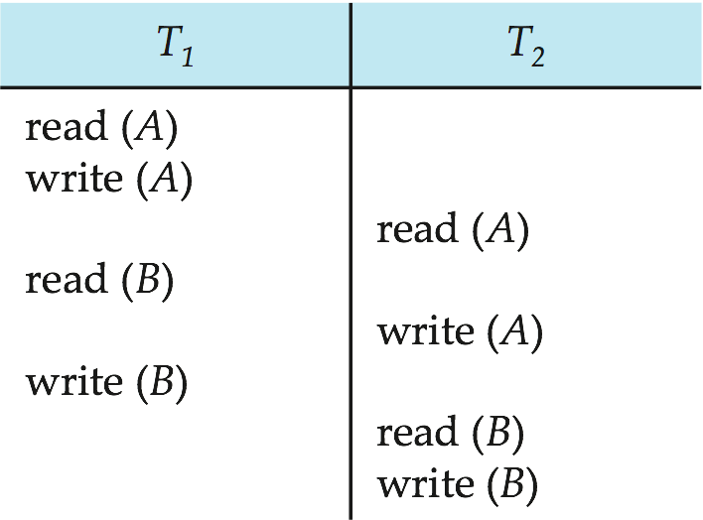
Figure 14.07

Slide 39
Figure 14.08

Slide 40

Figure 14.09

Slide 41
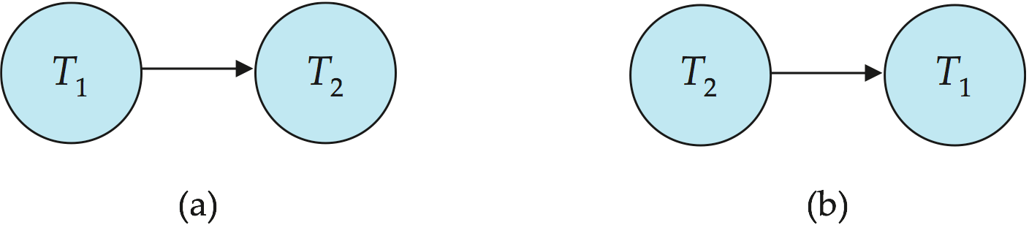
Figure 14.10

Slide 42

Figure 14.11

Slide 43

Figure 14.12

Slide 44

Figure 14.13

Slide 45

Figure 14.14

Slide 46

Figure 14.15

Slide 47
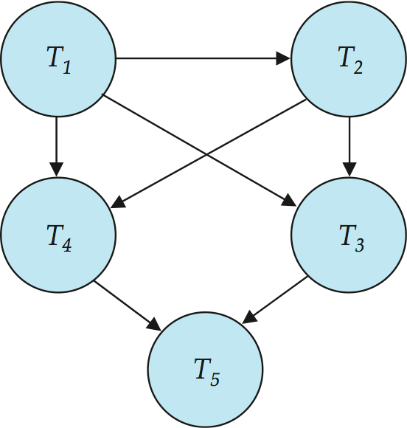
Figure 14.16

